Slide 1
Leveraging three types of instructional technologies to maximize student learning
Emily Springfield, MS Ed, University of Michigan

Slide 2
Session Objectives
Learn to categorize learning technologies by function
Learn which function promotes the most student learning
Learn a process for quickly determining they type of technology would meet your specific course needs

Slide 3

Making Sense of Learning Technologies
What does it do?
How is it different?
What are the other options?
Is it worth the time and money?
Is it a good choice for me?

Slide 4

Moving target
New technologies
Updates
New tricks for old dogs
Instead: learn a schema for quickly understanding new technologies

Slide 5
Digital Learning Technologies
X
The Cloud
Labs
ePortfolios
Blended
Learning
Textbooks
Online
Testing
MOOCs
Clickers
Electronic
Reserves
Tests
Mobile
Learning
LMS
Flipped
Classrooms
Lectures
Online
Courses
Wikis
Problem-based
learning
University of
Phoenix
Videoconferencing
Online
Video
Web 2.0
Digital
Textbooks
Blogs
Open
Educational
Resources
iPads
Educational
Gaming
Badges
Papers
Notes:
The world of learning technologies contains more than MOOCs, and not all learning technologies are digital.
How can you categorize learning technologies?

Slide 6
“Online Education”?
The Cloud
Labs
ePortfolios
Blended
Learning
Textbooks
Online
Testing
MOOCs
?
Clickers
Electronic
Reserves
Tests
Mobile
Learning
LMS
Flipped
Classrooms
Lectures
Online
Courses
Wikis
Problem-based
learning
?
University of
Phoenix
Videoconferencing
Online
Video
Web 2.0
Digital
Textbooks
Blogs
Open
Educational
Resources
?
iPads
Educational
Gaming
Badges
Papers
Notes:
“Online education” encompasses many clear technologies, but what about technologies that can be used for online and face-to-face courses?

Slide 7
“Blended Learning”?
The Cloud
Labs
ePortfolios
Blended
Learning
Textbooks
Online
Testing
MOOCs
Clickers
Electronic
Reserves
Tests
Mobile
Learning
LMS
?
Flipped
Classrooms
Lectures
Online
Courses
Wikis
?
University of
Phoenix
Problem-based
learning
Online
Video
Videoconferencing
Web 2.0
Digital
Textbooks
Blogs
Open
Educational
Resources
iPads
?
Badges
Educational
Gaming
Papers
Notes:
That’s usually called “blended learning” – but again, many technologies and techniques are not exclusively part of that group.

Slide 8
“Useful/Junk”?
The Cloud
Labs
ePortfolios
Blended
Learning
You gotta be kidding
Textbooks
Online
Testing
MOOCs
Clickers
Electronic
Reserves
Tests
Mobile
Learning
LMS
Flipped
Classrooms
Lectures
Online
Courses
Wikis
Problem-based
learning
How dare you??
University of
Phoenix
Videoconferencing
Online
Video
Web 2.0
Digital
Textbooks
Blogs
Open
Educational
Resources
iPads
Educational
Gaming
Badges
Papers
Notes:
Of course, you may just resort to making judgment calls about certain technologies – but since so much depends on implementation, no two educators will wholly agree on technologies that are perfectly useful or entirely junk.

Slide 9
Not really helpful!
Because…

Slide 10
It’s not the technology that matters…
Grandzol, J. R., C. A. Eckerson, and C. J. Grandzol. "Beyond no significant difference: Differentiating learning outcomes using multidimensional content analysis." Distance Education Online Symposium. Vol. 13. 2004.
Clark, Richard E. "Media will never influence learning." Educational Technology Research and Development 42.2 (1994): 21-29.
Coates, Dennis, et al. "“No significant distance” between face-to-face and online instruction: evidence from principles of economics." Economics of Education Review 23.5 (2004): 533-546.
Gwozdek, Anne E., et al. "Using online program development to foster curricular change and innovation." Journal of Dental Education 75.3 (2011): 339-350.
…it’s what you do with it.
Notes:
Again and again, for decades, we see research that says the teaching approach is more important than the technology used to enable that approach.

Slide 11
What we really need
Taxonomy based on function
Notes:
If we seek to understand technologies according to their instructional function, we can understand their potential much more quickly – or rule them out easily.

Slide 12
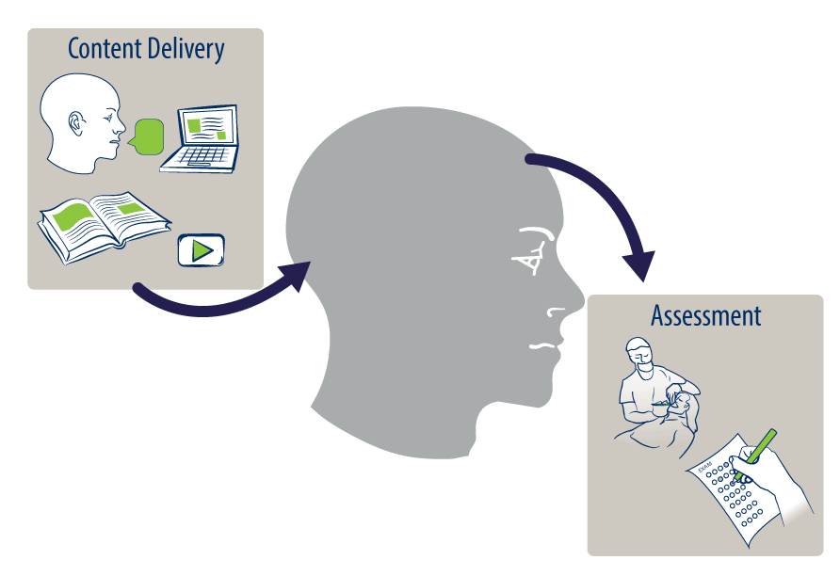
Three Learning (Technology) Functions
Notes:
Lecture/test is mostly delivery and assessment.
Engagement is where most deep learning happens. Assessment helps us figure out what students have learned.

Slide 13
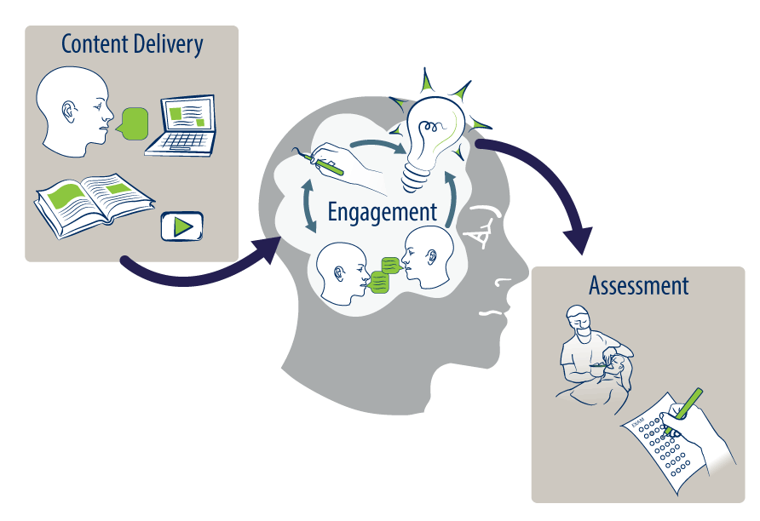
Three Learning (Technology) Functions
Perception of control
Perception of progress
Connectedness
From Zappo’s vision of engaged employees
Notes:
Lecture/test is mostly delivery and assessment.
Engagement is where most deep learning happens. Assessment helps us figure out what students have learned.

Slide 14
Your Turn

Slide 15

What function does it serve?
Lets you record procedure demos and play them back
Lets students record themselves doing a procedure and send the video to you
Lets students record themselves and comment on each other’s videos

Slide 16
Content Delivery Technologies
Written words
Spoken words
Images
Content Delivery

Slide 17
Content Delivery Technologies
Written words
Spoken words
Images
Analog
Analog
Digital
Analog
Digital
Digital
Content Delivery
Notes:
Almost all learning tech has analog and digital versions

Slide 18
Content Delivery Technologies
Written words
Spoken words
Images
Analog
Analog
Digital
Analog
Digital
Content Delivery
Textbook
Instructor notes
Lecture
Demo
Photos
Diagrams
Video
Digital
Journal
3D
Notes:
Some specific learning tech in each category

Slide 19
Engagement Technologies
?
Engagement
“Studying”
Problem-solving
Practicing
Discussing and Peer teaching
Notes:
What is “studying,” anyway? We know “good” learners are constantly processing as they listen and study – taking notes in their own words, asking and answering questions, running examples, connecting to other knowledge.

Slide 20
Engagement Technologies
Engagement
Problem-solving
Practicing
Discussing and Peer teaching
Analog
Digital
Synchronous
Analog
Analog
Solving cases
Face-to-face
Asynchronous
Digital
Simulation
Practice questions
Homework problems
Digital
Games
Notes:
“Engagement” is any activity that requires students to do something with information. Beyond listening; must apply, create, question, connect, etc.

Slide 21
Assessment Technologies
Written work
Assessments
Performance

Slide 22
Assessment Technologies
Written work
Assessments
Performance
Analog
Analog
Digital
Digital
OSCE
Video
Simulation
Test
Presentation
Paper
Problem set

Slide 23
Building a list
Brainstorming list of technologies and their functions

Slide 24
Tech | Function | Tech | Function
Online testing | Assess/ ENgage
Videoconference | Content Del. / Engage
YouTube Video (variations) | CD
Record lecture | CD
Audience response | Engage/ Assess
DentSim | Engage/ Assess
VitalSource (online text) | CD

Slide 25
So what?
We have categories…how does that maximize learning?

Slide 26

The easiest thing for students…
Notes:
The easiest thing for students to do is to ingest content – and they can do it without YOU.

Slide 27
Content Delivery ≠ Retention
Notes:
Just because you said it, doesn’t mean they learned it. You can get students to remember more – and be able to apply it more deeply – if you reduce content delivery and increase engagement.

Slide 28
Engagement Fosters Learning
Making Connections
Application
Practice
Problem-solving
Feedback
Confirming
Correcting
Relating to known material
Refining
Adding detail
Understanding exceptions
Similarities and differences

Slide 29
Engagement Fosters Learning
  Relating to known material
  Similarities and differences
Create opportunities for students to:
  Expand on prior learning
  Compare/contrast
  Relate to previous step
  Start by teaching the end step/state
Making Connections
Your examples?

Slide 30
Engagement Fosters Learning
Practice labs
Clinical work
Ddx flash cards
  Practice
  Problem-solving
Application
Your examples?

Slide 31
Engagement Fosters Learning
Am I right?
Am I wrong?
Am I close?
You don’t have to give all the feedback
  Peers
  Computer-based
#1 most desired learning intervention
Your examples?
Feedback
  Confirming
  Correcting

Slide 32
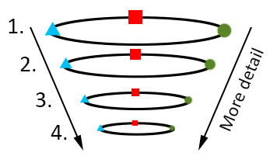
Engagement Fosters Learning
“Linear” instruction
  1, 2, 3, 4
  1, 2, 3, 4
  etc.
“Spiral” instruction
  1, 1, 1
  2, 2, 2
  etc.
Refining
  Adding detail
  Understanding exceptions
Notes:
Both work! Spiral is especially good for teaching interconnected concepts
Keep in mind that a neophyte can only absorb so many nuances at once. If there’s a detail about blue triangle 3 that you can only understand if you also understand red square three, there’s no way a person who doesn’t understand the relationship between blue triangle and red square 2 will be able to understand, let alone remember, it.
Especially useful for training tasks: both easy case/medium case/difficult case and how to do it/why to do it/discern whether to do it

Slide 33
Restructuring class time

Slide 34
Common Allocations of Class Time
Notes:
There’s a lot of engagement in our curricula – but what happens between the lecture and the clinic? Students forget everything, or they never really understood how to apply the didactic knowledge in the first place.

Slide 35
Maximizing student learning
Which tech to add to a traditional course?
Read (cont. del.)
Lecture (cont. del.)
Test
What are their functions?
Watch video
Clicker questions
Simulation/case
Before class
During class

Slide 36
Maximizing student learning
Students are not performing well on final exam
Read (cont. del.)
Lecture (cont. del.)
Test
What does this course lack?
Watch video
Clicker questions
Simulation/case
Before class
During class

Slide 37
Maximizing student learning
Students are not performing well on final exam
Read (cont. del.)
Lecture (cont. del.)
Test
Intersperse questions
Watch video
Clicker questions
Simulation/case
Before class
During class

Slide 38
Maximizing student learning
Students are not performing well on final exam
Read
Case – in pairs
Test
Watch video
Clicker questions
Simulation/case
Before class
During class

Slide 39
Selecting New Technology
A method
Notes:
So you’ve decided your course needs some help, and you’re wondering about incorporating some sort of technology to facilitate that. How do you choose?

Slide 40
Decision tree
Define Problem
What category would help?
Select tech from category

Slide 41
Decision tree example
Students can’t see procedure demo
Content delivery
On-demand video
Determine problem
Which function?
Pick a technology

Slide 42
Decision tree example
Bad oral path ddx
Engagement
Self-quiz with images and case info
Determine problem
Which function?
Pick a technology

Slide 43
Session Wrap-up
What are the three general functions of learning technologies?
  Content delivery, engagement, assessment
Which function promotes the most student learning?
  Engagement
What are the three steps of the process for quickly determining they type of technology would meet your specific course needs?
  Define problem
  Decide which function is needed
  Choose a technology from that category

Slide 44
Questions?
Emily Springfield
University of Michigan
espring@umich.edu

Slide 45
Group Work
Your choice of topics!

Slide 46
Group discussion topics
Brainstorm engagement opportunities
  In your courses
Workshop a single course design problem
  Start by defining the desired learning improvement outcome
Make a wish list
  What functions, tools, or services would help you increase learning in your courses?

